Slide 1
Fruit and Vegetable Detection using OpenCV and Deep Learning
Md Asaduzzaman Jabin
Graduate Student
School of Electrical and Computer Engineering
University of Georgia, GA-30602
Email: mj71006@uga.edu

Slide 2
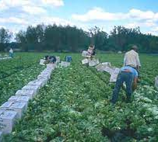
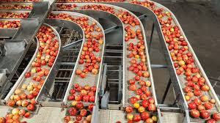
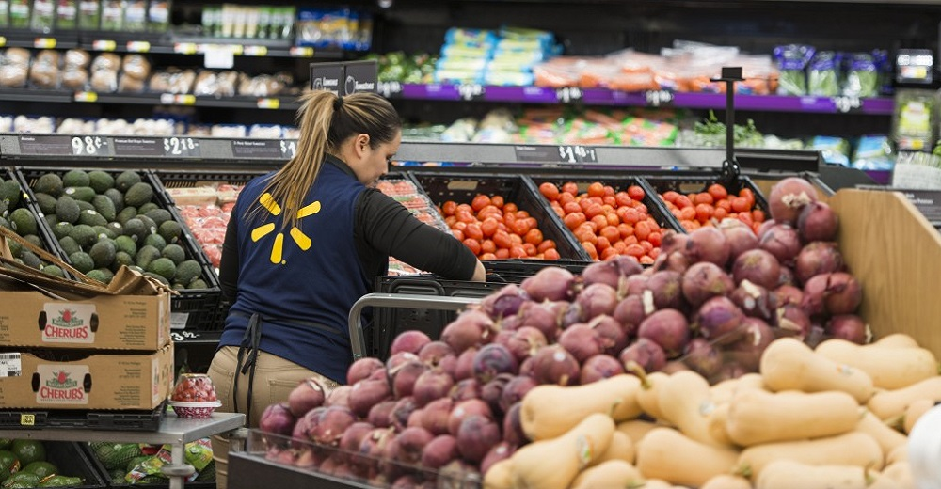
Motivation
Manual Harvesting by skilled farm labor
Food Processing
Why is it so important?
Manual Harvesting involved:
Labor Cost
Equipment Cost
Training and Supervision Cost
How Fruit and Vegetable Detection is important?
Retailer Business
Fruit Picker/Sorter: 50000 People migrated from 30 countries.
Global Annual Market Size: $1 Trillion, CAGR 16.5%
https://www.mordorintelligence.com/

Slide 3
Literature Review
Object Detection Algorithm
The problem of fruit detection as an image segmentation problem and detection
Wang et al. (2012), apple detection, based on color and specular reflection, average size is the cutoff.
Bac et al. (2013), sweet pepper, based on six band multi-spectral camera, entropy-based texture features.
Hung et al. (2013), almond segmentation (grayscale), sparse auto-encoder, complex/ only can handle low occlusion
Yamamoto et al. (2014), Classifier and Regression Trees (CART) classifier, grouped connected pixels into regions.
Issues:
Pixel-level segmentation
Slow, system lag
Controlled environment –glass house environment
Less Variability in scale and appearance of the target objects
Solution:
Multimodal DNN features and DNN models- MobileNetV2
Huge data mapping capacity
Can handle wide variation of environments and appearance
Light weight, can handle real-time
https://www.ncbi.nlm.nih.gov/pmc/articles/PMC5017387/
mj71006@uga.edu

Slide 4
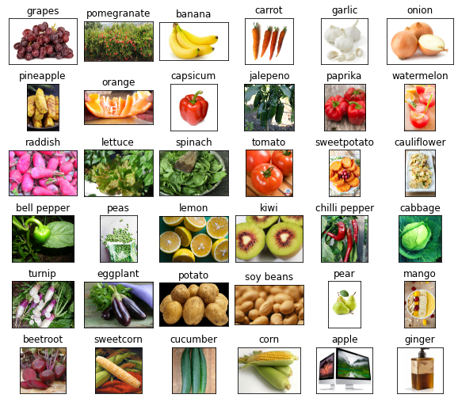
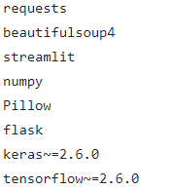
Introduction to Object Detection: Web app
Backend
Frontend
Data set
Kaggle (2020), Fruits and Vegetables Image Recognition Dataset
https://www.kaggle.com/datasets/kritikseth/fruit-and-vegetable-image-recognition
35 classes (10 fruits and 25 vegetables)
Train set: 3500, Validation set: 350, Test set: 350
1. Access and Load data
Load New Data
2. Preprocess
3. Derive Features
Web App
GUI
4. Model Training
5. Model Tuning
6. Testing Result
Detect a Fruit/ Vegetable
Saved model
MobileNetV2
Overall Workflow
Output
mj71006@uga.edu

Slide 5
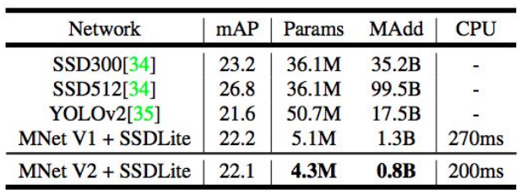
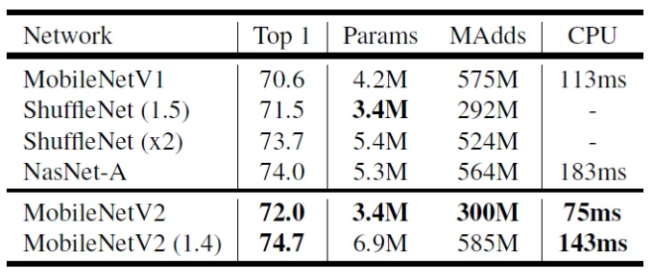
Why MobileNetV2 with ImageNet Pre-trained weights?
MobileNetV2, CNN architecture, Google research (2018), designed for efficient mobile and embedded vision applications.
Efficiency: Very efficient in terms of computation and memory usage compared to VGG, ResNet, EfficientNet, ShuffleNet, etc.
Less Computation: A depthwise convolution and a pointwise convolution.
Smaller memory footprint: channel pruning and quantization
Accuracy
Flexibility
Transferability
https://towardsdatascience.com/review-mobilenetv2-light-weight-model-image-classification-8febb490e61c
mj71006@uga.edu

Slide 6
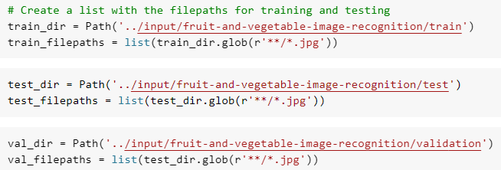
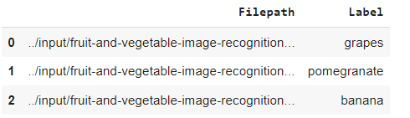
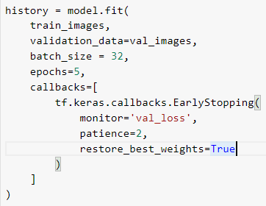
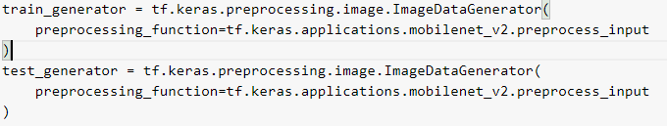
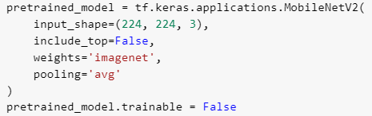
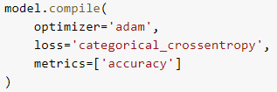
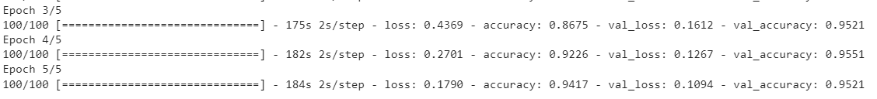
1. Access and Load data
Prepare Frontend (Fruit_Veg_Classification_Mobilenet.ipynb)
2. Preprocess
3. Derive Features
4. Model Training
5. Model Tuning
6. Result
mj71006@uga.edu

Slide 7

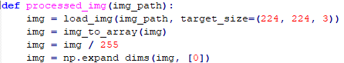
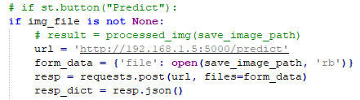
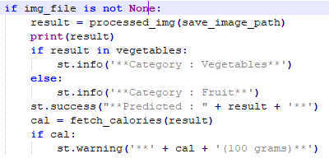
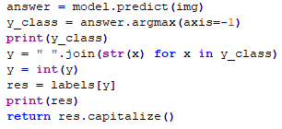
Load New Data
Web App backend
Preprocess
Web App
GUI
Saved model
MobileNetV2
Detect a Fruit/ Vegetable
Output
mj71006@uga.edu

Slide 8
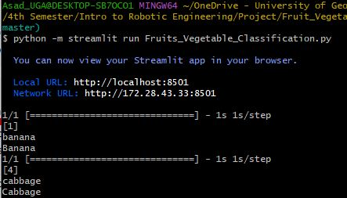
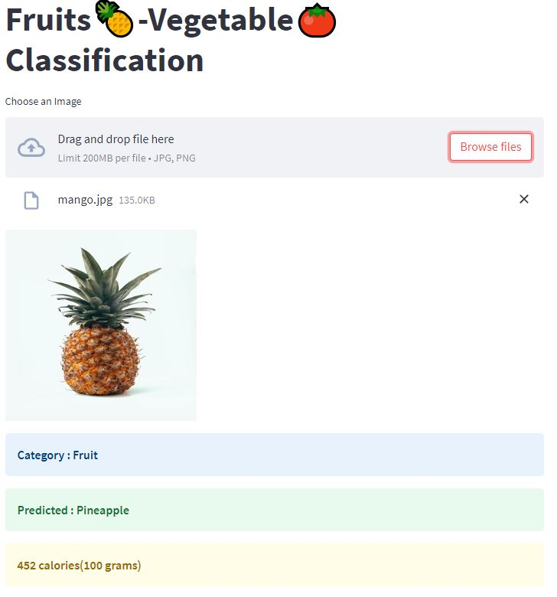
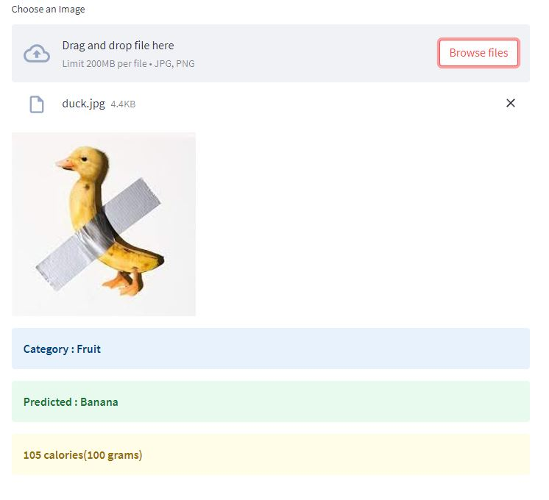
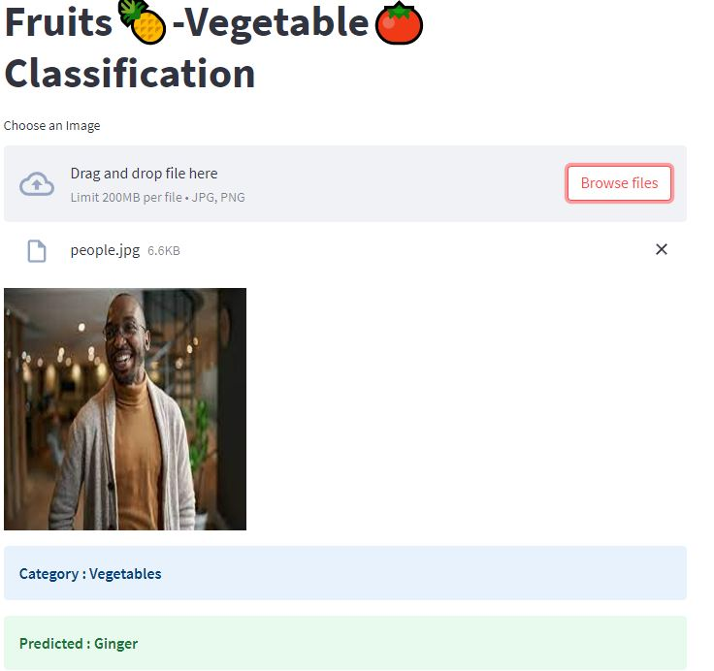
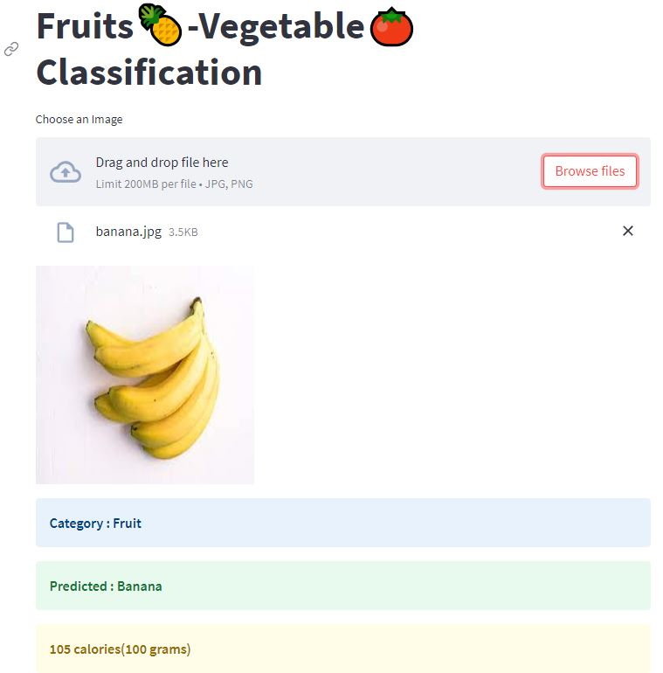
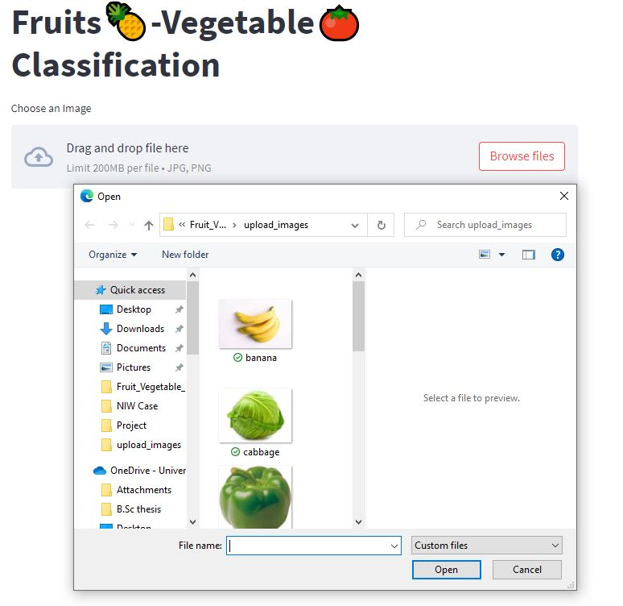
Testing the App
Critical Cases
Mislabeled
Misleading
Misclassified
It proved that MNetV2 is successfully transferable!
mj71006@uga.edu

Slide 9
Thank You!
Question?

